Slide 1

Bike-Share Analysis
A step-by-step workbook walkthrough
1 Jan–14 Feb 2011
1,000
hourly records
01

Slide 2

STEP 1 / Merge
Source tables and the join key
dataset_1
dataset_2
610 records
610 records
Date, hour, weather and other
descriptive fields
Casual and registered riders,
total rides and other measures
Common key: instant
dataset_a combines the matching records
into 610 rows with 16 base columns.
02

Slide 3

STEP 2 / APPEND
The consolidated analysis table
610 + 390 = 1,000
dataset_a
dataset_3
dataset_b
Match the same 16 base columns before appending.
The consolidated table contains 1,000 unique instant IDs.
Every record satisfies cnt = casual + registered.
03

Slide 4

STEP 3 / ENRICH
Readable labels for analysis
Date labels
Stored labels show year, month and weekday names.
Category names
Readable labels accompany season, weather
and weekday codes in the analysis table.
Day type
Holiday takes priority. Otherwise, weekday
codes 0 and 6 identify the weekend.
Retain the original numeric codes alongside the readable labels.
04

Slide 5

STEP 4 / VALIDATE
Data checks before reporting
Reference checks
No #REF! formulas found in this workbook.
All 1,000 records pass cnt = casual + registered.
Pivot totals
Saved Sunday pivots total 8,121 rides.
The full dataset totals 58,304. Check filter scope.
Season coding
Data has 997 Spring records and one each for
Summer, Fall and Winter. Verify these three codes.
Humidity formula
MOST_HUMID_DAY uses atemp instead of hum.
Use column L and anchor the full data range.
05

Slide 6

STEP 5 / SUMMARIZE
Full-data KPIs and pivot setup
58,304
58.3
total rides
average rides per hourly record
53,383
4,921
registered rides (91.6%)
casual rides (8.4%)
Pivot rows: hour, month, weekday or weather
Values: sum of rider counts, or average of cnt to compare demand
06

Slide 7
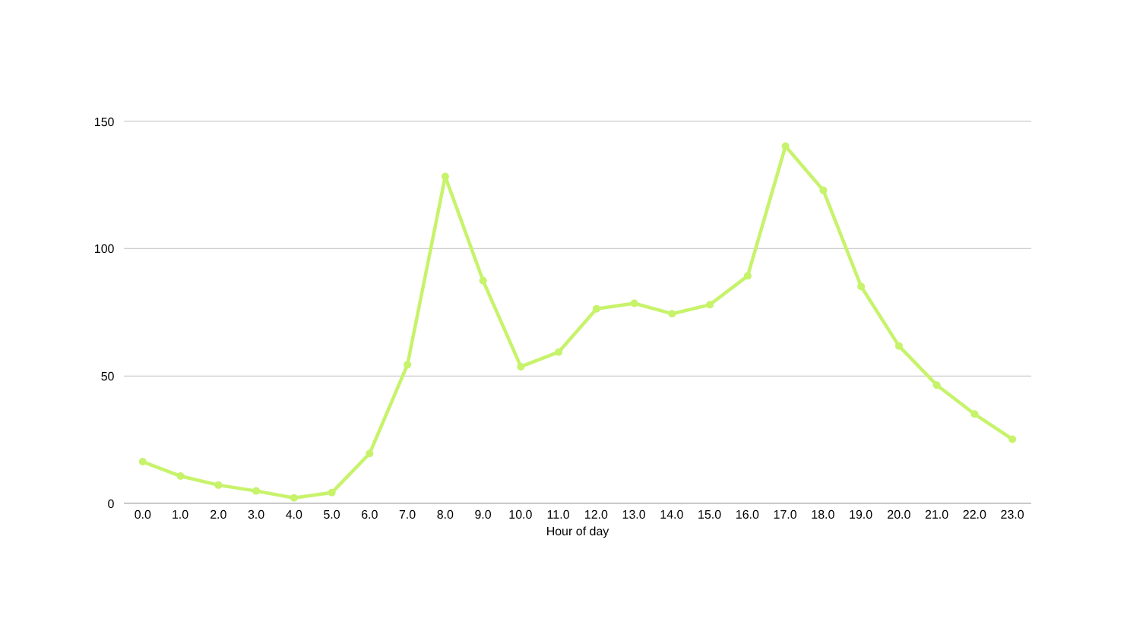
STEP 6 / VISUALIZE
Hourly demand peaks at 17:00
Average rides per hourly record
140.2
17:00 peak
128.3
08:00 peak
07

Slide 8
STEP 7 / INTERPRET
Operational actions and limits
Actions supported by the data
Limits on interpretation
Prioritize bike availability around
07:30–09:00 and 16:00–19:00.
Only 45 calendar days of data.
February ends on the 14th.
Protect registered-rider reliability.
This segment accounts for 91.6% of rides.
Review season coding. Heavy rain
has only one observation.
Use weather forecasts in planning.
Rain averages 33.2 rides versus 61.7
in clear weather.
Treat differences as descriptive.
Add more months before making
annual capacity decisions.
08

Slide 9

STEP 8 / FORECAST
Forecast for 15–21 February 2011
9,643
57.4
forecast rides across seven days
average forecast rides per hour
207.2
168
peak forecast rides in one hour
forecast hours
Expected peak: Thursday 17 February at 08:00
Method: historical averages for the same weekday and hour.
09

Slide 10
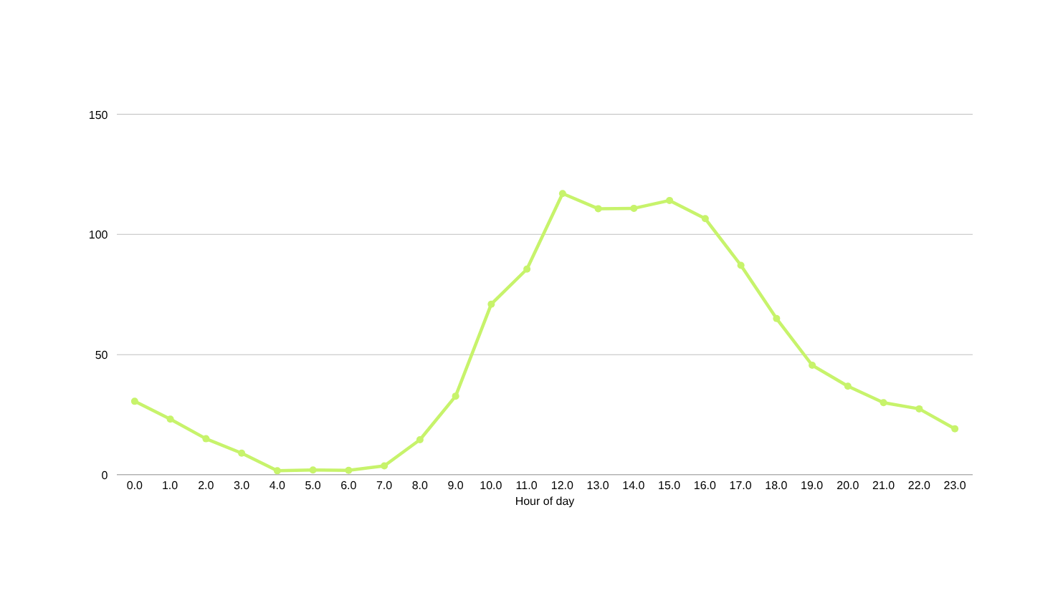
STEP 9 / DASHBOARD
Dashboard: Sunday demand
Saved Sunday view: 8,121 rides, averaging 49.5 per hourly record
117.0
12:00 peak
40.5
registered / hour
40.5 is average registered rides per hour, not a percentage share.
10

Slide 11


Thank you
Submitted by : Nirmala Bisht
11

